Slide 1
Ares I-X Aeroelastic and Structural Dynamics Modeling for GN&C Simulations
Eugene Heim
Ares I-X GN&C Deputy Lead
NASA Langley Research Center
Aeroservoelastics Simulation Workshop
National Institute of Aerospace
April 18-19, 2012

Slide 2
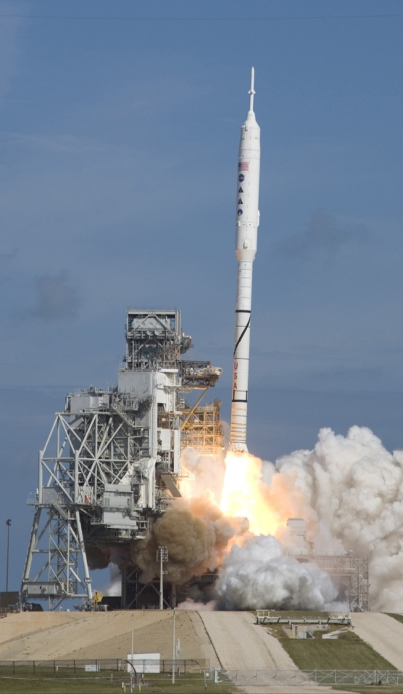
Ares I-X
Structural dynamics major concern for Ares I
Highest slenderness ratio of any vehicle ever flown
First bending mode within control bandwidth
Phase stabilization of first bending mode required
Gain stabilization of higher modes
Ares I-X provided early flight test of first stage flight for model and modeling method validation
Dynamically scaled at liftoff
Dummy upper stage, Orion/LAS, and 5th segment
Made with surplus materials…
Booster & TVC – expired Shuttle RSRM
RoCS – disassembled from Peace Keeper ICBM
BDM’s and BTM’s – Old Shuttle BSM motors
Avionics – Atlas V
Primary objectives
Demonstrate control of dynamically similar vehicle to Ares I
Perform staging similar to Ares I
Demonstrate assembly and recovery of new first stage element at KSC (ground ops)
Demonstrate first stage recovery system
Characterize internal RSRM roll torque
Flown October 28th, 2009 11:30 AM

Slide 3
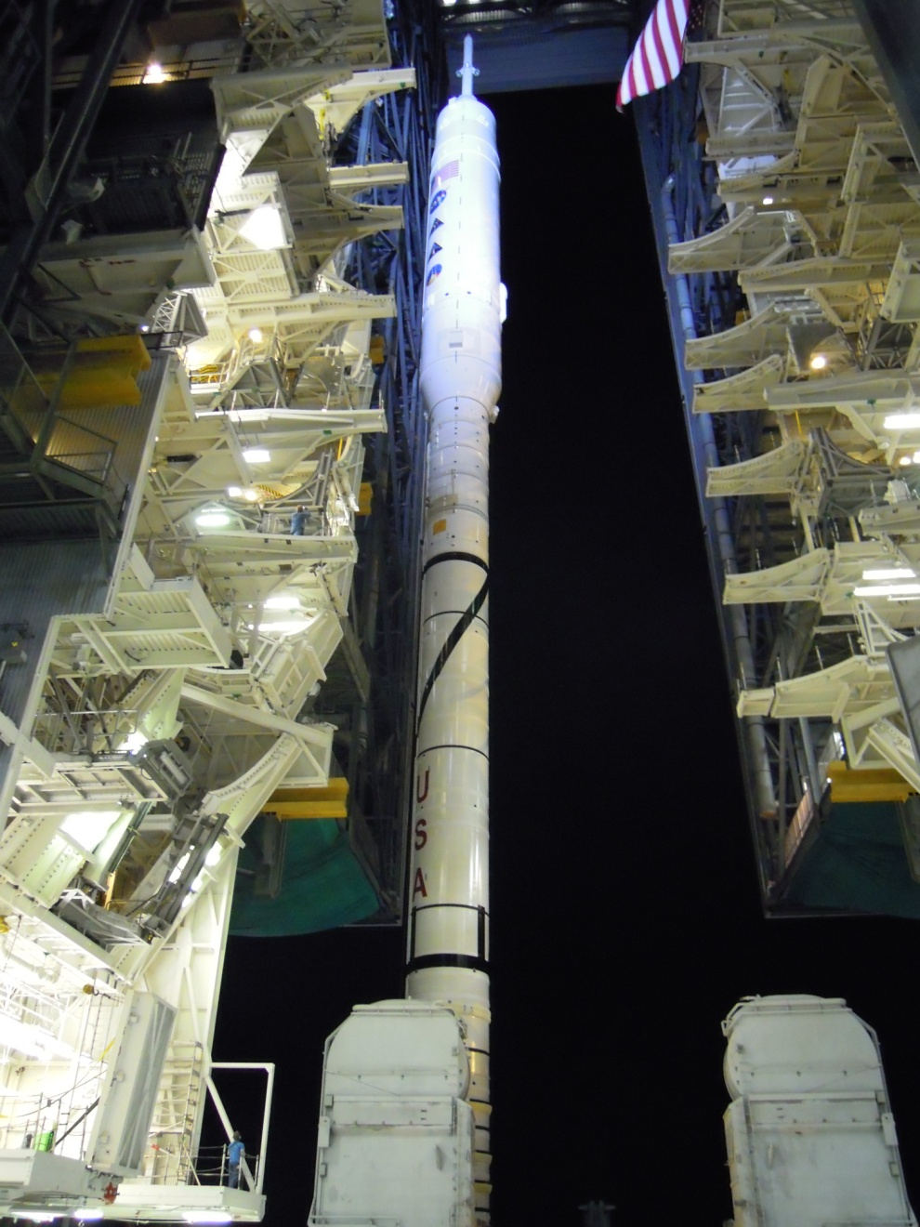
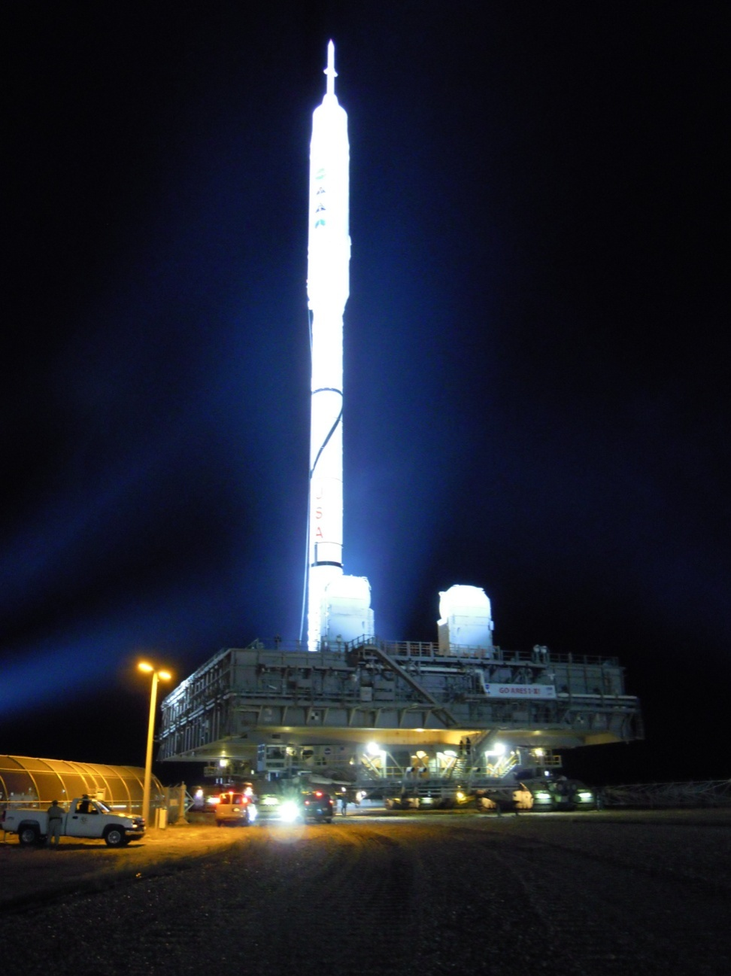
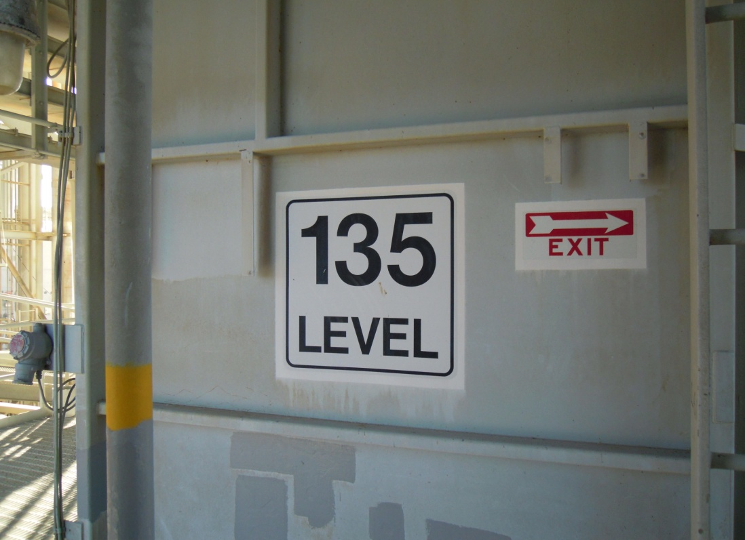
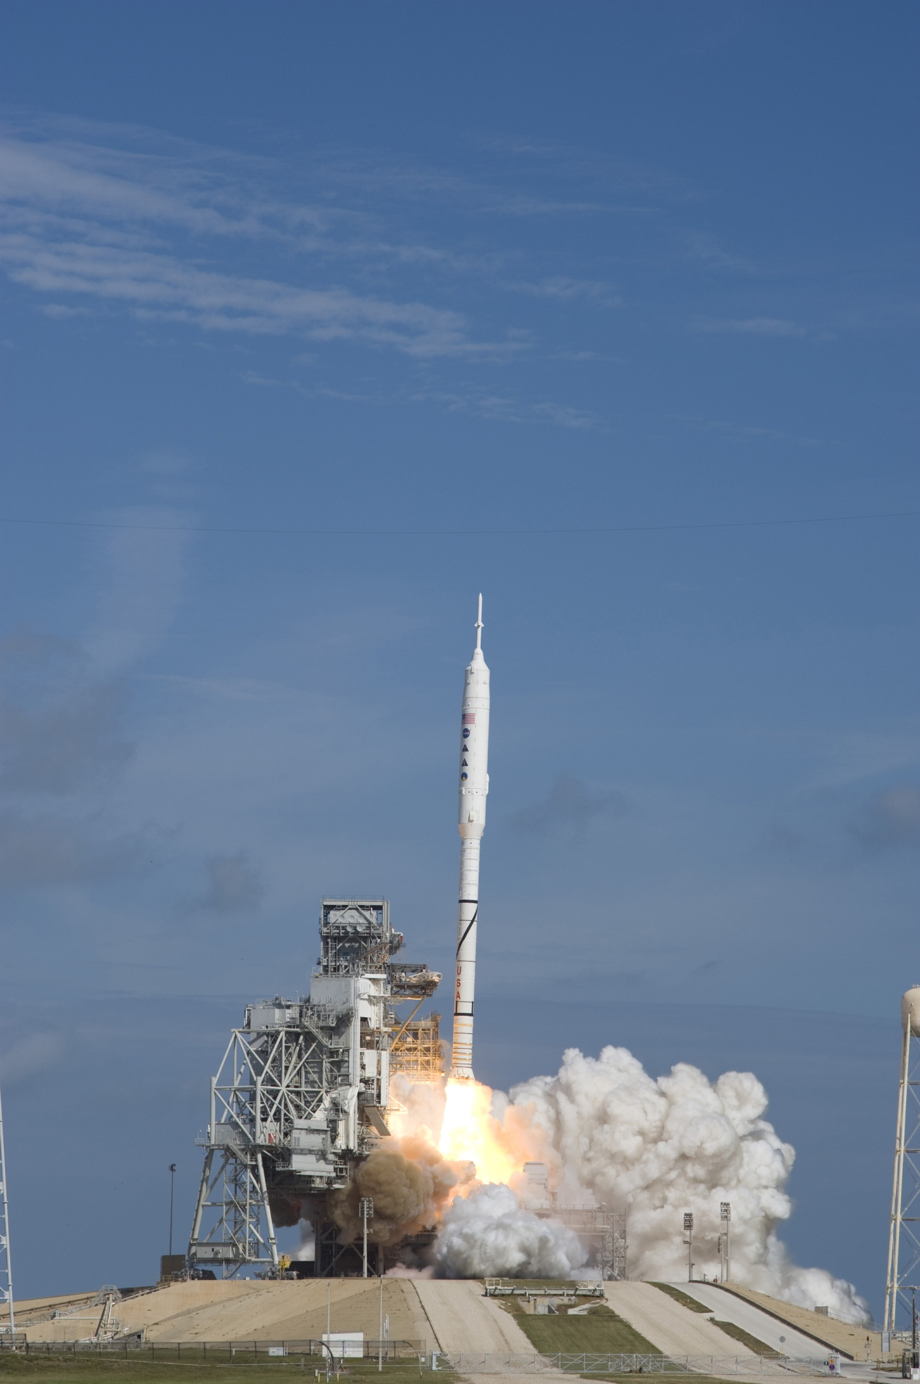
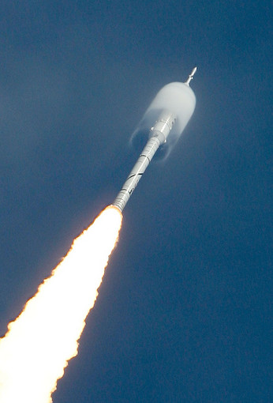
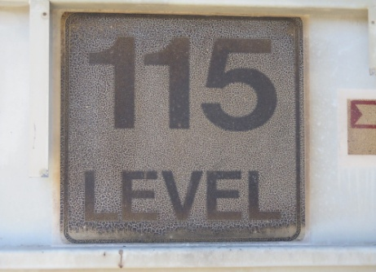
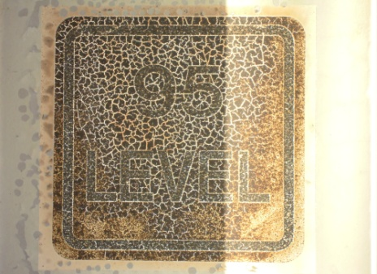
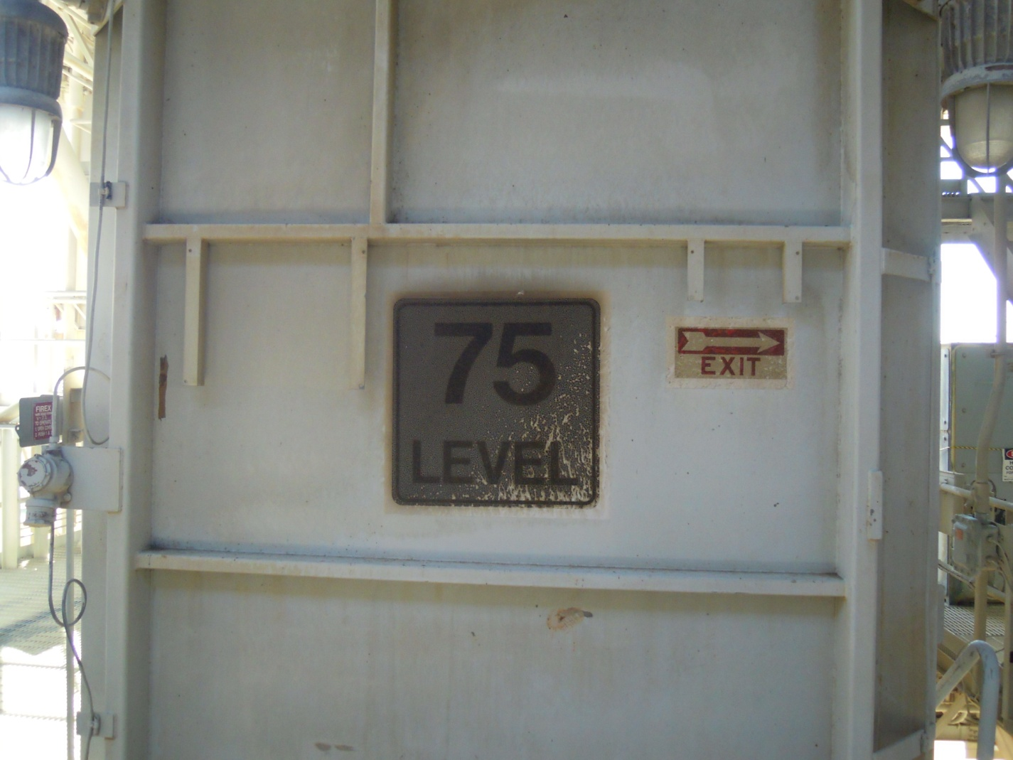
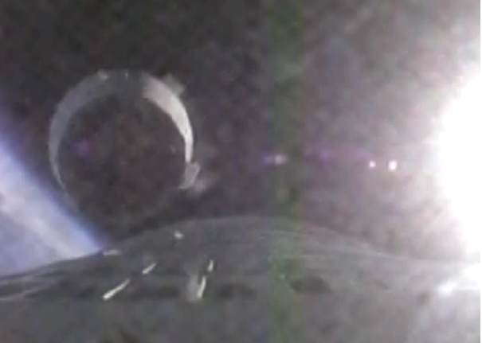
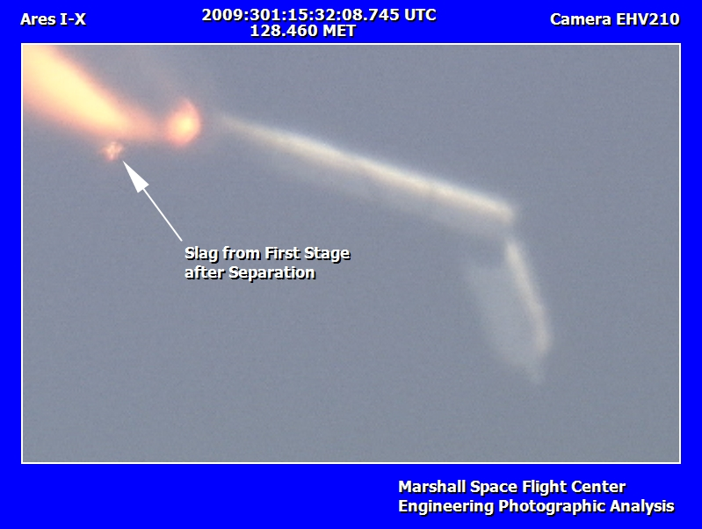
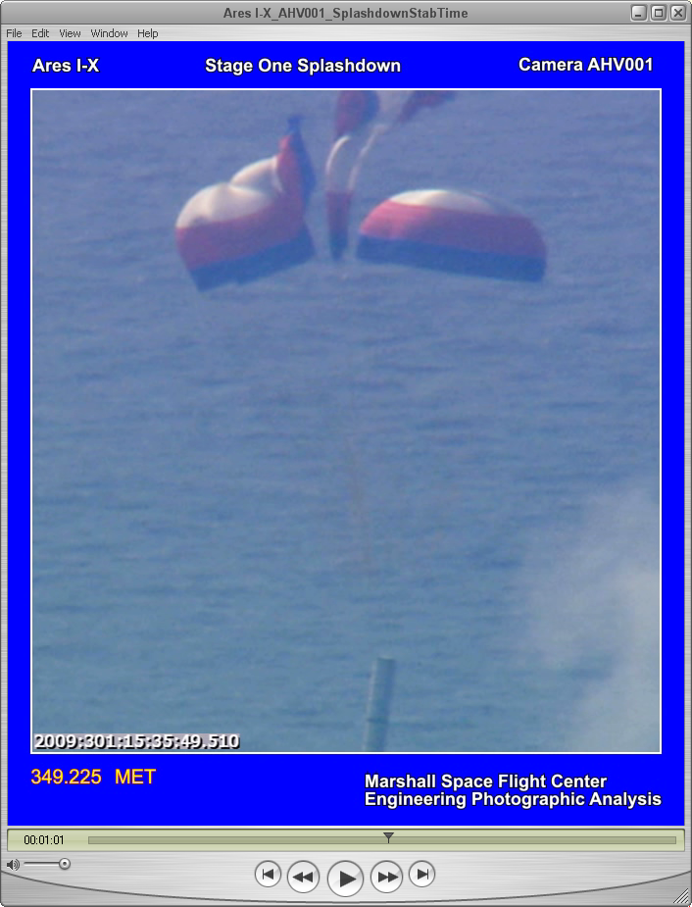
Flight Overview

Slide 4
Aeroservoelastic Impacts on GN&C Design
Control law design required knowledge of first few bending modes
Mode shapes influenced sensor placement and blending
Mode frequencies influenced filter design and stabilization strategy
Modal damping influenced effectiveness of control
Mode shapes, frequencies and even damping changed in time as fuel mass was depleted
Required gain scheduling and scheduling of filter coefficients
Ensure nodes and anti-nodes of phase stabilized modes do not cross sensors
Program Test Inputs (PTI’s) throughout flight
Open loop TVC excitations and roll control blackouts
TVC commands: 3 sets of orthogonal sum-of-signs and 1 pulse to excite structure
Used to verify phase stabilization of first bending mode, excite aerodynamics, identify structural damping, and RSRM roll torque
Axial, torsion and higher order bending modes needed for other analysis
Ares I thrust oscillation first discovered in early Ares I-X analysis by including axial mode and first acoustic mode of RSRM chamber
Torsion mode allowed roll control thrusters to excite sensors leading to roll rate filter
Clearance studies such as liftoff, staging, jettison, etc. as well as flight reconstruction require best knowledge of deformation, i.e. all the modes

Slide 5
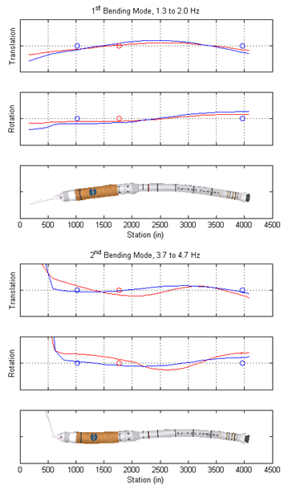
Sensor Locations and Mode Shapes
Similar to Ares-I design
Baselined identical architecture Feb 2007
Major differences from Ares-I for ascent flight
Sensor locations
Structural dynamics
Filter and gain coefficients
RRGU
FTINU
RRGU

Slide 6
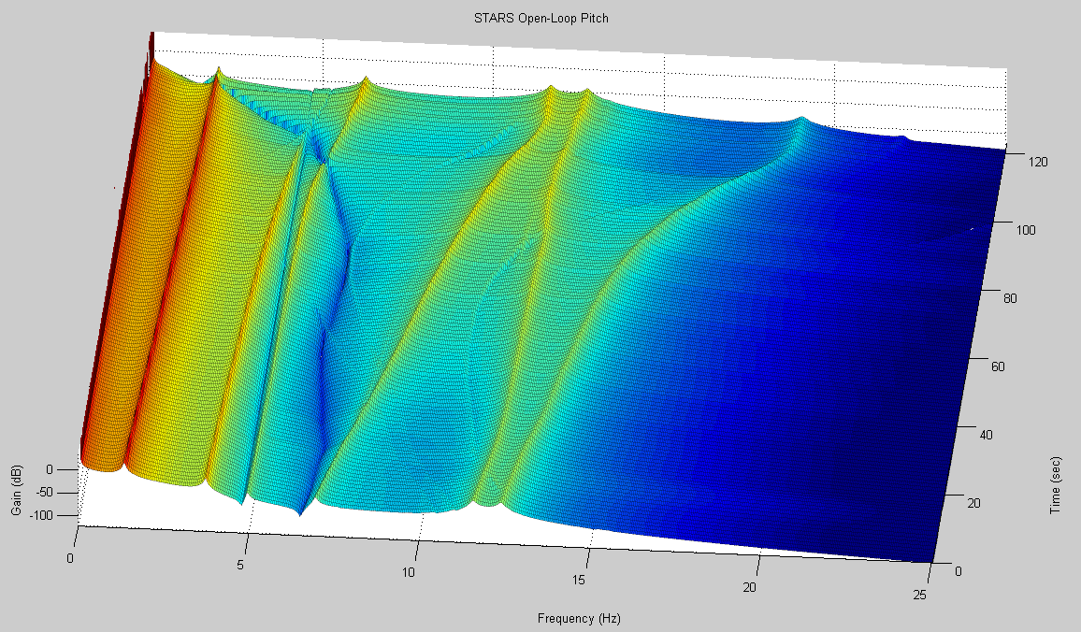
STARS Pitch Open Loop Gain
3rd Bending Mode
4th Bending Mode
6th Pitch Bending
1st Bending Mode
5th Bending Mode
2nd Bending Mode
Sensor Blending Zero
Tail-Wags-Dog Zero

Slide 7
Key Points Linear Stability Analysis

Slide 8
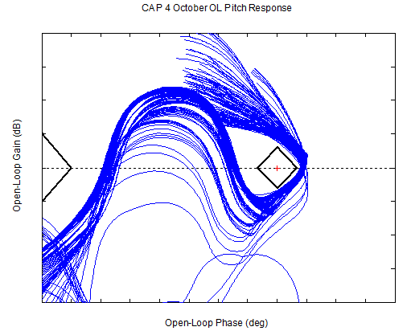
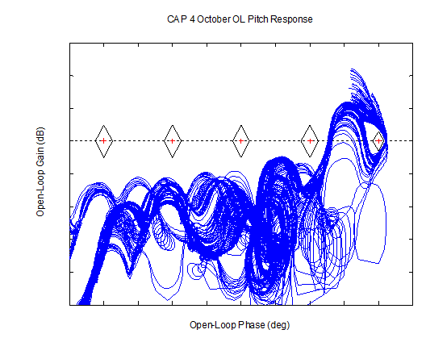
Baseline Nichols Charts
Linearizations from STARS
Baseline trajectory
Computed every second from 1 to 120 seconds

Slide 9
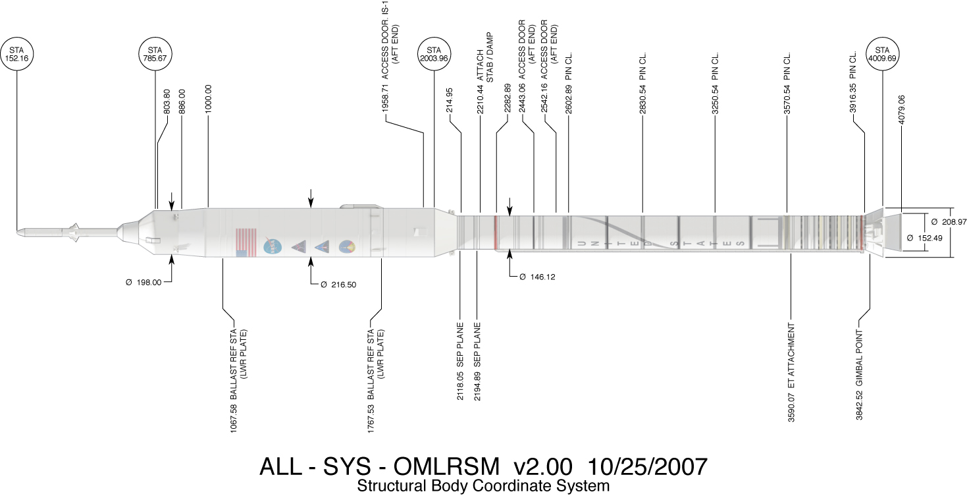
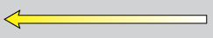
Modal Models
13 models representing mass conditions every 10 sec. of flight
All modes under 25 Hz with 27 residual vectors
Each model included 73 nodes (54 centerline, 3 sensor, 2 gimbal, 4 HDP, 2 nozzle centerline and 4 actuator attachment)
Evaluated with RSRM pressurized “prestiffened” modes
Other models: MLP mounted model, first stage alone and upper stage alone
FTINU 1770.3
Centerline
Sensor
RoCS
Nozzle
HDP
Actuator
CG
FWD RRGU 1023.8
AFT RRGU 3962.9

Slide 10
Structural Dynamics Modeling
Standard second order flexible body EOM for each elastic mode
Modal eigenvector and values from NASTRAN
Damping ratio of 0.5% for all modes
Linear superposition of elastic modes onto rigid-body dynamics
Variable mass structural modeling techniques used
Constant modes - hold one set at a time constant throughout flight
Stepping - discrete changes from model to model
No model formatting required
Allows for dispersed sets of FEM models
Care must be taken when switching models to minimize transients
Modal interpolation - continuous piecewise linear interpolation
No modification to modes
Requires labor intensive modal tracking, sorting and consistent mode signs
Some loss of orthogonality
Liftoff and staging events used least squares technique
Dispersed frequencies and mode shapes directly
Scale factor on frequencies
Scale factor and artificial shifts (centerline) on mode shapes

Slide 11
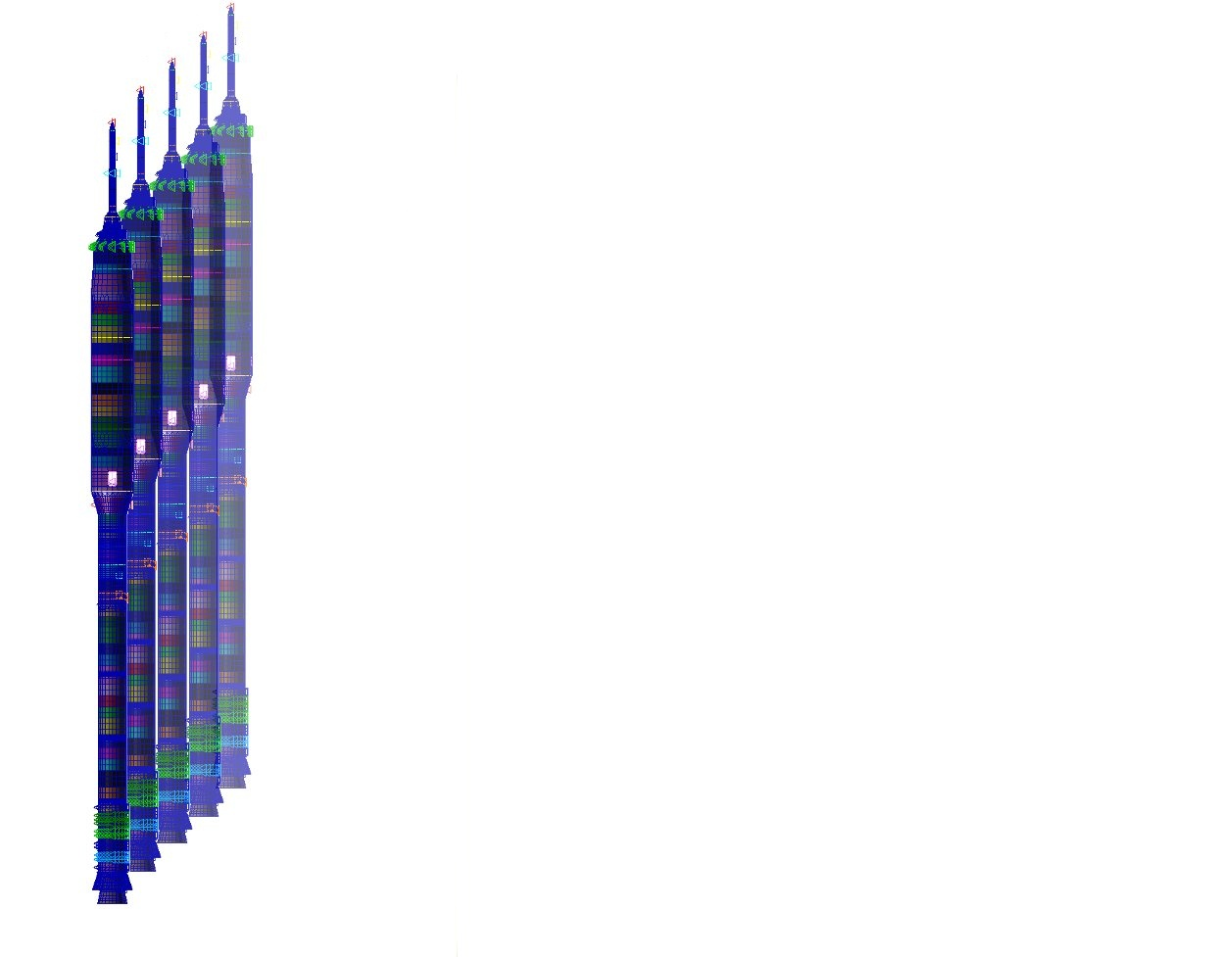
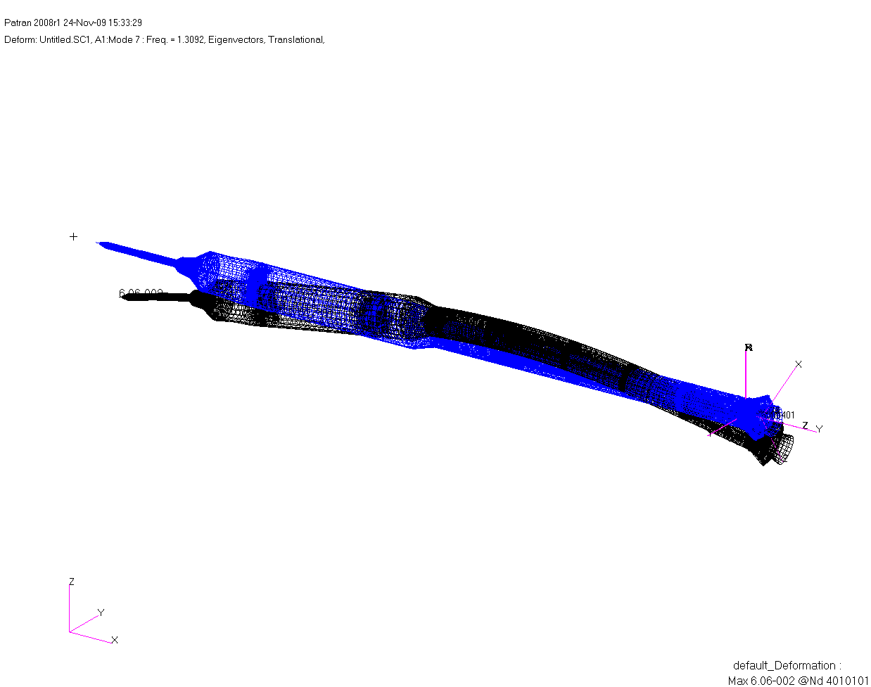
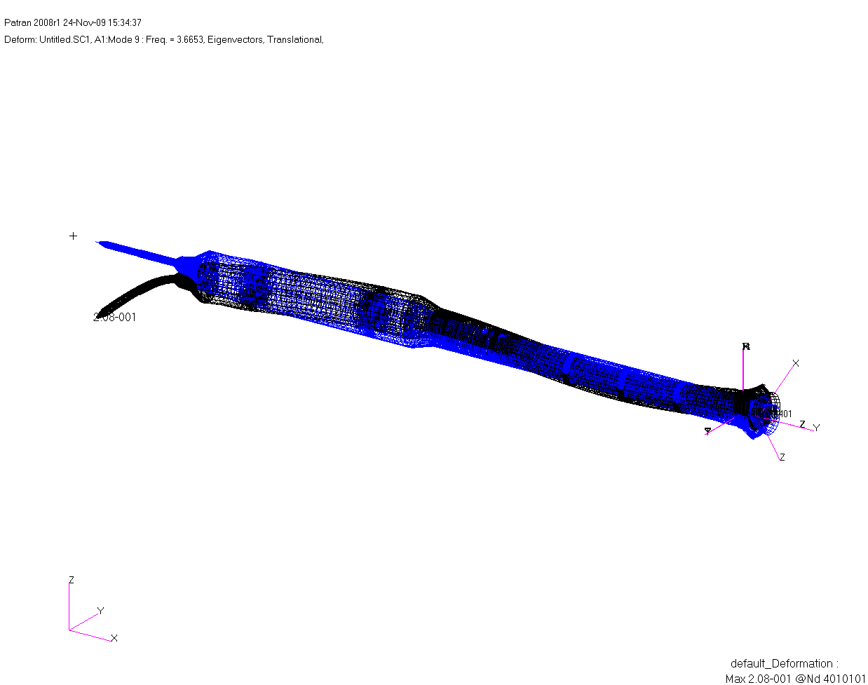
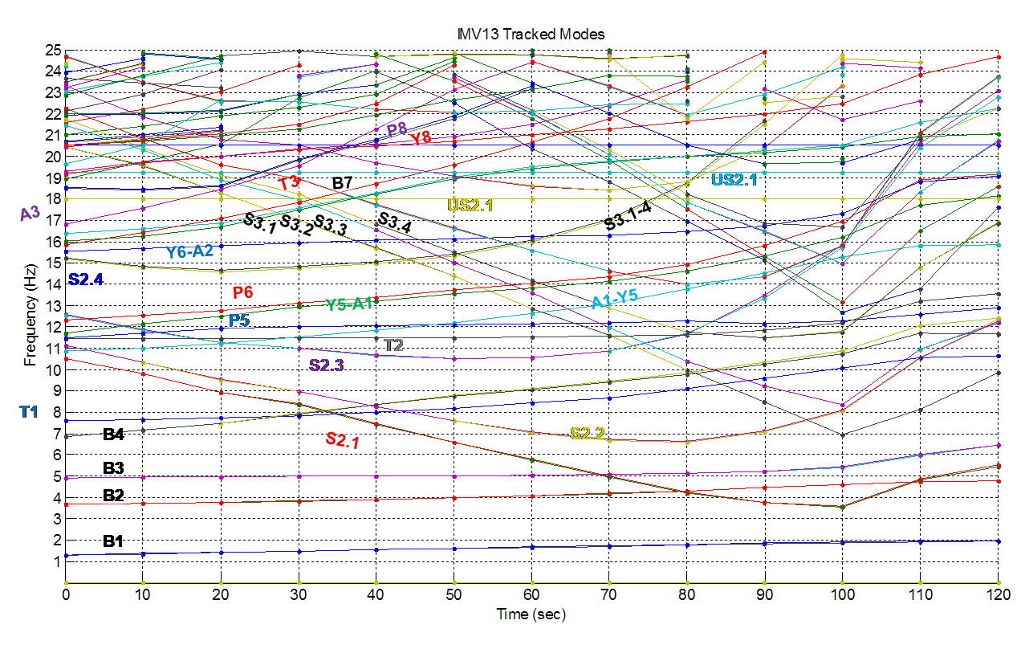
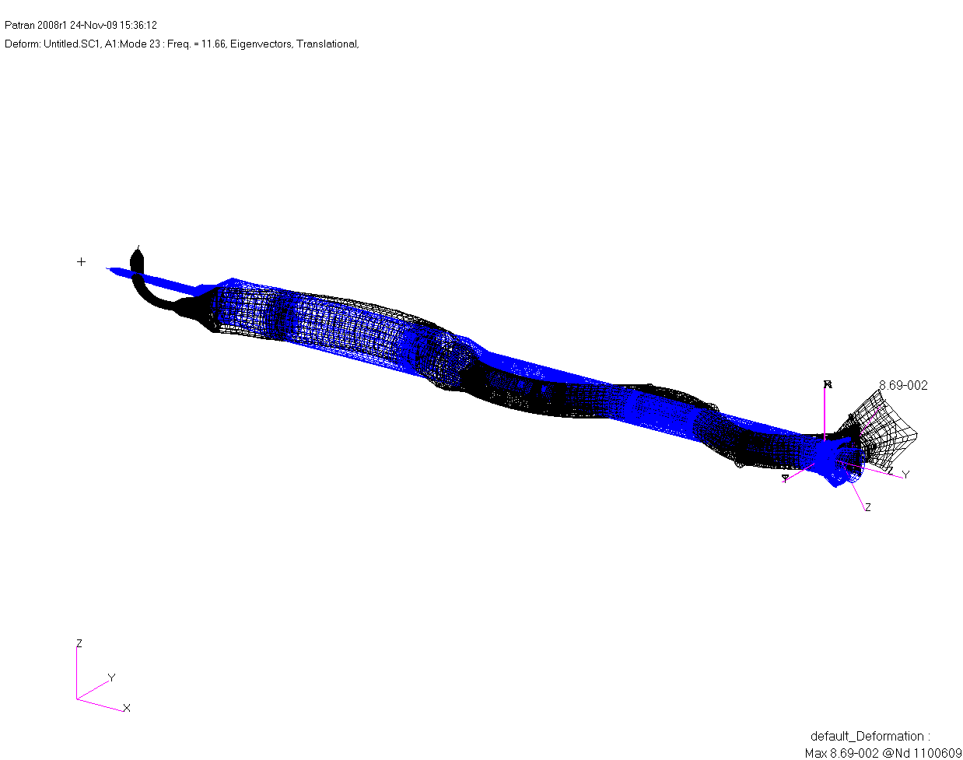
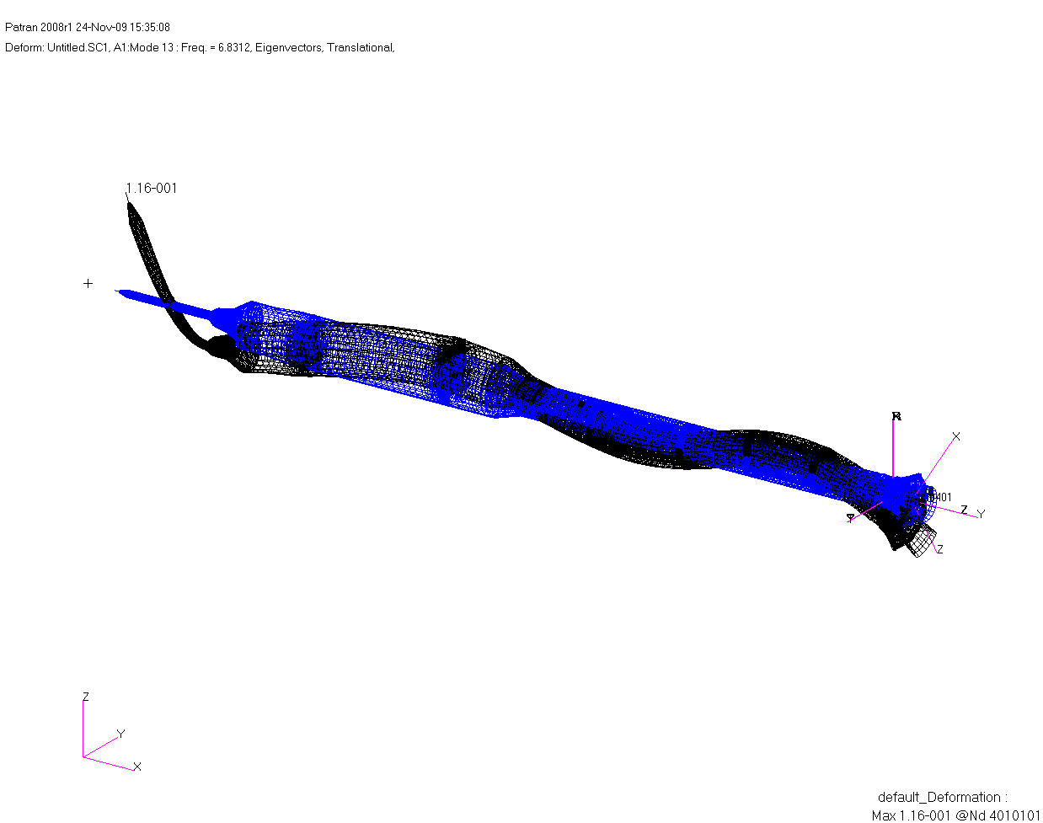
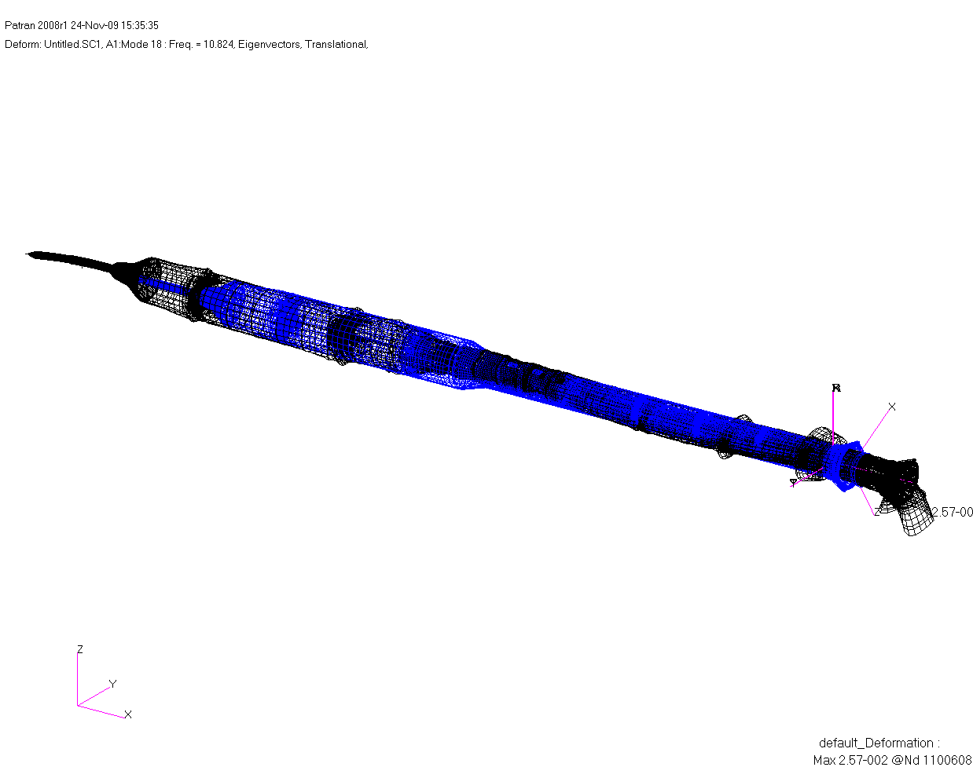
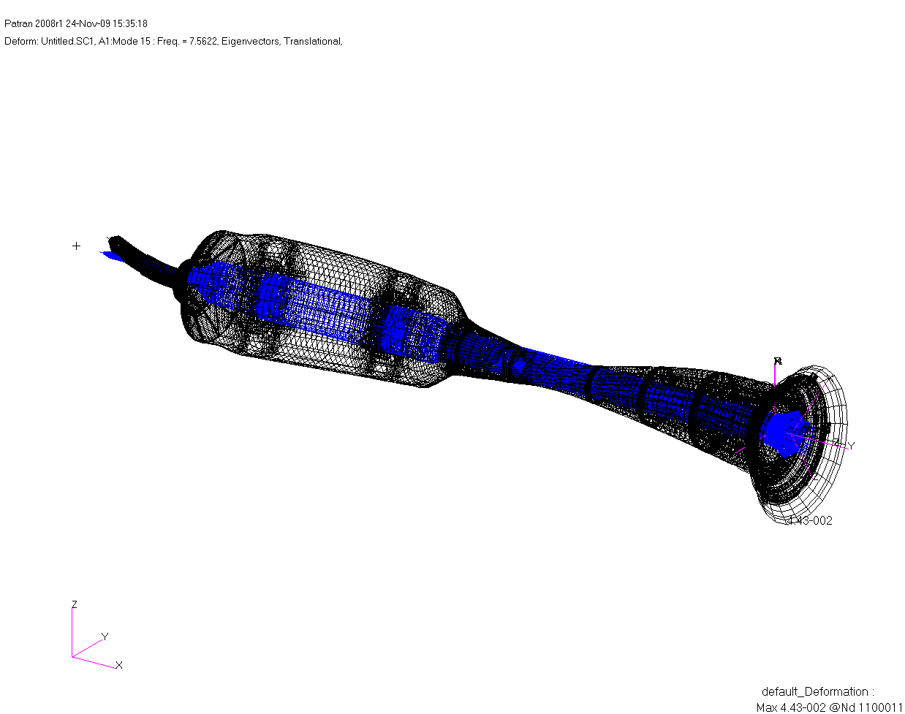
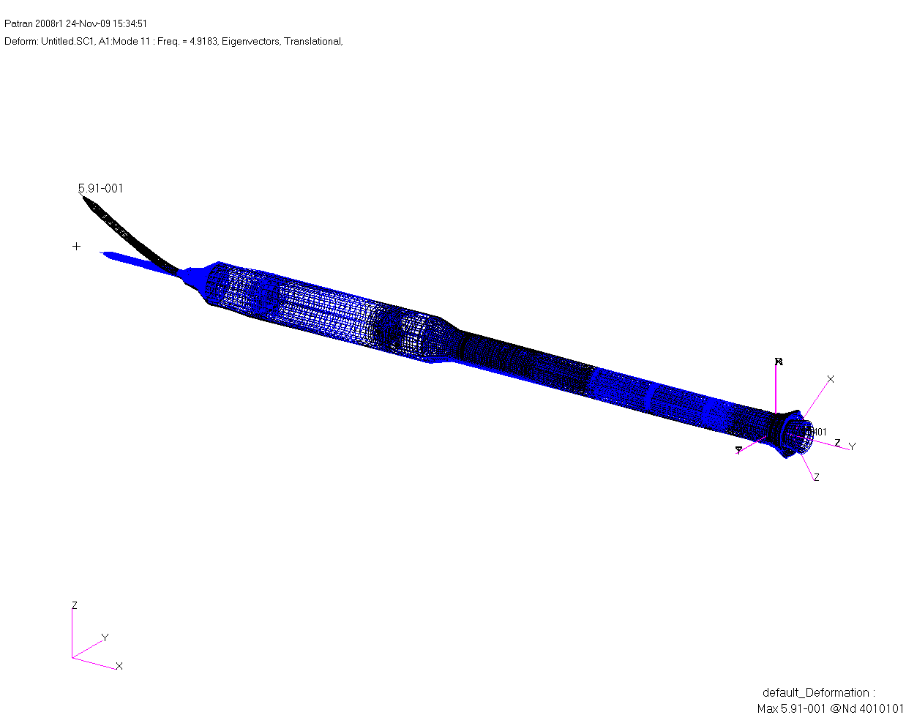
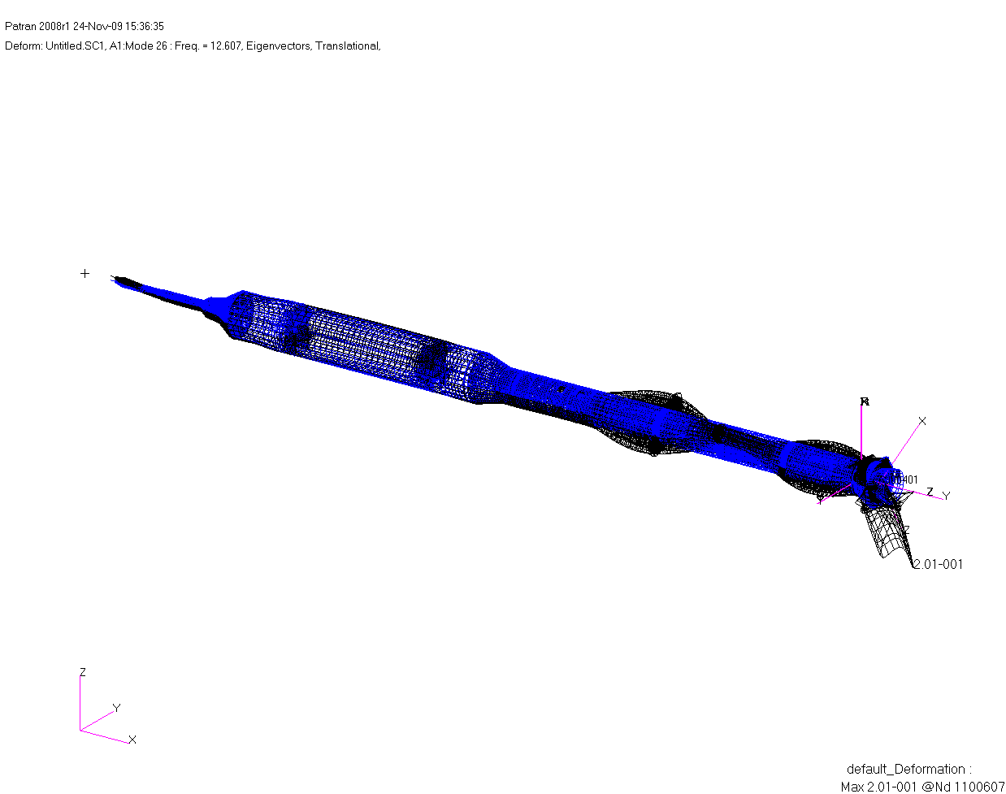
Modal Interpolation
Modal selection based on Hankel-singular values (controllability and observability)
FCS can only resolve frequencies up to 25 Hz, sensor bandwidth ~10 Hz, pitch and yaw control bandwidth ~2 Hz
Retain at least first 3 bending mode pairs, 1st axial and 1st torsion
Modal tracking with cross-orthogonality and by hand with Patran
Requires engineering judgment when modes combine or coalesce
T=40s
T=30s
T=20s
T=10s
Modal Decomposition
Modal Tracking and Interpolation
T=0s

Slide 12
Modeling Dynamics on MLP
Vehicle on pad loaded by
Gravity field
Centripetal relief (due to Earth rotation rate)
Winds (steady, gusts)
Reaction from MLP
Thermal, etc. (not modeled)
Flexible body
Lumped masses used to load nodes due to body accelerations (gravity and centripetal relief as function of node altitude)
Stiffness is linear, i.e. vehicle will not continue to bend due to its own weight
Deformation at Hold Down Post (HDP) release used to initialize free-free modes
Rigid-body
Held in place by ground reaction model until compressive loads at HDP are zero
Structural dynamics on MLP used to initialize rigid-body EOM at HDP release

Slide 13
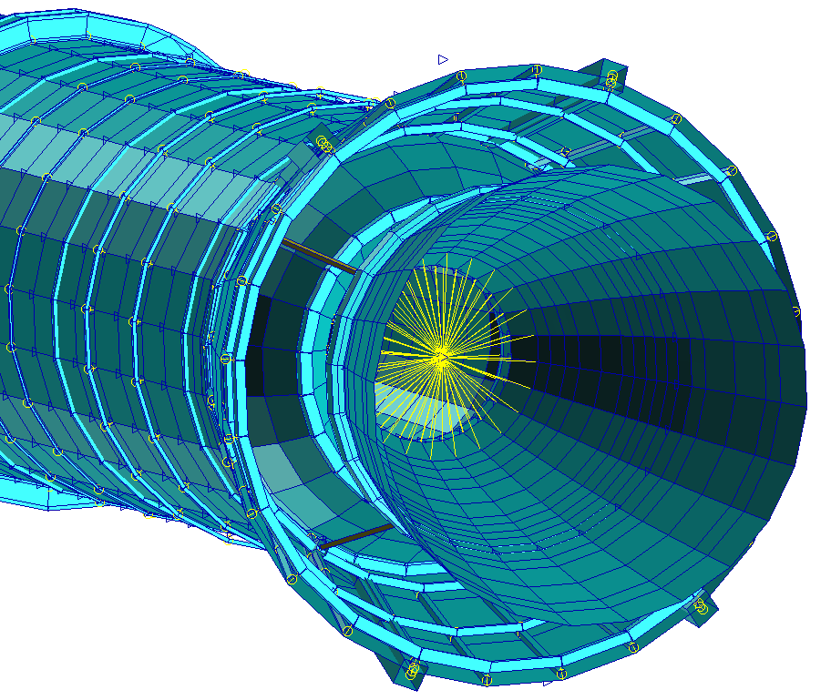
Actuator Model & Structural Compliance
Shuttle heritage actuator model (Linear Simplex)
Standalone model includes nozzle and associated compliances
Several dispersible parameters
Structural model includes nozzle and “locked actuators”
Actuator-structural modeling “double-dipped” actuator, flex bearing and back-up structure compliance
Negligible 0 to 3 deg. shift in phase margin around first bending mode
FCS
&
Sensors
Rock Actuator
Gimbal node wagon-
wheeled to nozzle
Structural
Deformations
Actuator
Commands
FCS - Actuator Model - Structural Model Interaction
Vehicle
Structural Dynamics
Actuator
Structural Dynamics
Structural
Model
Actuator
Model
“Locked Actuator”
Nozzle Dynamics
Gimbaling
Nozzle Dynamics
Tilt Actuator
All Other Loads
Lateral Thrust,
TWD & DWT
fwd

Slide 14
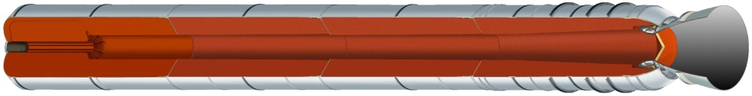
Propulsion Models
Reusable Solid Rocket Motor (RSRM)
Submerged nozzle with flex bearing
Chamber pressure stiffens and expands pressure vessel and compresses flex bearing causing nozzle to rotate due to kinematic coupling with actuators
Nozzle rotation due to chamber pressure known as “deterministic error” and book kept in a separate model… possible double bookkeeping.
RSRM structural exciters
Axial thrust applied to structural model at forward dome node
Lateral thrust components applied at gimbal node on nozzle side of flex bearing.
Roll torque applied to aft dome node
Optional thrust oscillations added via generalized pressures
Roll Control System (RoCS)
Each thruster had specific node to apply thrust
Rigid body forces transformed and translated due to structural deformation
Lateral Thrust
Axial Thrust
Roll Torque

Slide 15
Force Following Debate
Force following transforms a force acting on the structure by the structural deformation. Creates feedback loop, input depends on output.
Real structures with attached lateral forces will bend non-linearly
Free-free assumed modes from NASTRAN will not
Debate between GN&C and Structural communities
Surveyed Ares I, Shuttle, Atlas, Delta, and Aerospace Corp.
In each case GN&C group used force following
All but 1 structures groups recommended not to
Should accelerations be rotated by slope or not?
Impact for Ares I-X was negligible, 0 to 5 deg. phase shift of first bending mode
Apply lateral force to model
Simple beam example
No change in force vector
Bending mode excited
Force following rotates applied force
Force following
Bending and axial modes excited

Slide 16
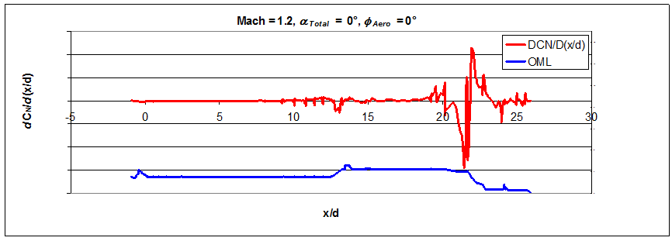
Distributed Aerodynamics
Distributed line load coefficients used to simulate quasi-static aeroelastics on flexible body
Distributed aero databases for ascent and liftoff
Scaled to match corresponding integrated coefficients
Local dynamic pressure, Mach, α_{Total} and Φ_{Aero} at each centerline node used to compute forces at node
Not applied to rigid body dynamics

Slide 17
Aeroelastic Increments
Thrust vector increments
Negligibly stabilizing/destabilizing depending on Mach number, nominally less than 1 deg and 1 dB on all margins
FCS kept gimbal angles small which kept effect small
Dynamic pressure-alpha total increments
Negligibly destabilizing, nominally less than 1 deg and 1 dB on all margins
Unsteady aerodynamics explored but not incorporated into sim
Lots of work on reduced order model coupled with structural model
Affects damping of structural modes: increase or decrease with dynamic pressure

Slide 18
Summary and Conclusions
Aeroelastics negligible impact for Ares I-X
Expected result with no significant lifting surfaces
May be more of an issue for more flexible Ares-I
More work needed to incorporate unsteady aero into GN&C simulations
Structural dynamics significant for Ares I-X, more so for Ares-I
Major driver in GN&C design and analysis
Large range in modeling techniques throughout community
Relatively small difference in results between techniques for Ares I-X
More work needed in modeling mass varying systems
Additional structural dynamics techniques subsequently developed for Ares-I and SLS
Constant set of shape functions, P. Tobbe (DCI-MSFC), AIAA-2009-6023
Least Squares Quadratic Inequality, J. Wetherbee (SAIC-MSFC)

Slide 19


